Slide 1
NOAA Operational SAR Sea Surface Wind Products
William Pichel – NOAA/NESDIS STAR
Frank Monaldo – JHU/Applied Physics Laboratory
Christopher Jackson – Global Ocean Associates
Xiaofeng Li – IMSG at NOAA/NESDIS
John Sapper – NOAA/NESDIS/OSPO
Xiaofeng Yang – Chinese Academy of Sciences
IGARSS 2011 – July 2011

Slide 2
NOAA Operational SAR Sea Surface Wind Products
1. Introduction
SAR Wind Algorithm
Operational SAR Winds Software Architecture
SAR Wind Products
Wind Product Accuracy

Slide 3
NOAA SAR Wind Background
1999 - Experimental SAR winds production began
2005 - Major upgrade to APL NOAA SAR Wind Retrieval System (ANSWRS)
2009 - Transition to operations approved
4. 2011 – Begin testing new operational SAR winds product system
3. 2012 – Complete operational implementation

Slide 4
NOAA SAR Winds Operational Goals
1. Implement operational production of SAR-derived high-resolution winds in NOAA/NESDIS Office of Satellite and Product Operations (OSPO)
2. Be capable of deriving winds from all readily available SAR satellites and modes
3. Develop a system which can be easily modified to handle future operational SAR data from Sentinel-1 and RADARSAT Constellation Mission
Develop compatibility with other international SAR wind production systems and products – in particular Environment Canada Operational SAR winds.

Slide 5
SAR High-Resolution Coastal Winds Users
User community:
Currently: NWS offices and CoastWatch users in Alaska and Washington National Ice Center
General Public
Eventual Goal: NWS offices in all U.S. coastal areas,
Canadian meteorological offices,
NOAA Emergency Response Division,
NOAA Marine Sanctuaries,
CoastWatch users,
Hurricane and Typhoon Centers,
General Public
Benefit to user:
Coastal weather forecasts which directly impact safety of fishing and transportation,
Identification of atmospheric boundary layer phenomena
Search and rescue
Coastal wind climatology, wind farm placement
Understanding detailed severe storm morphology

Slide 6
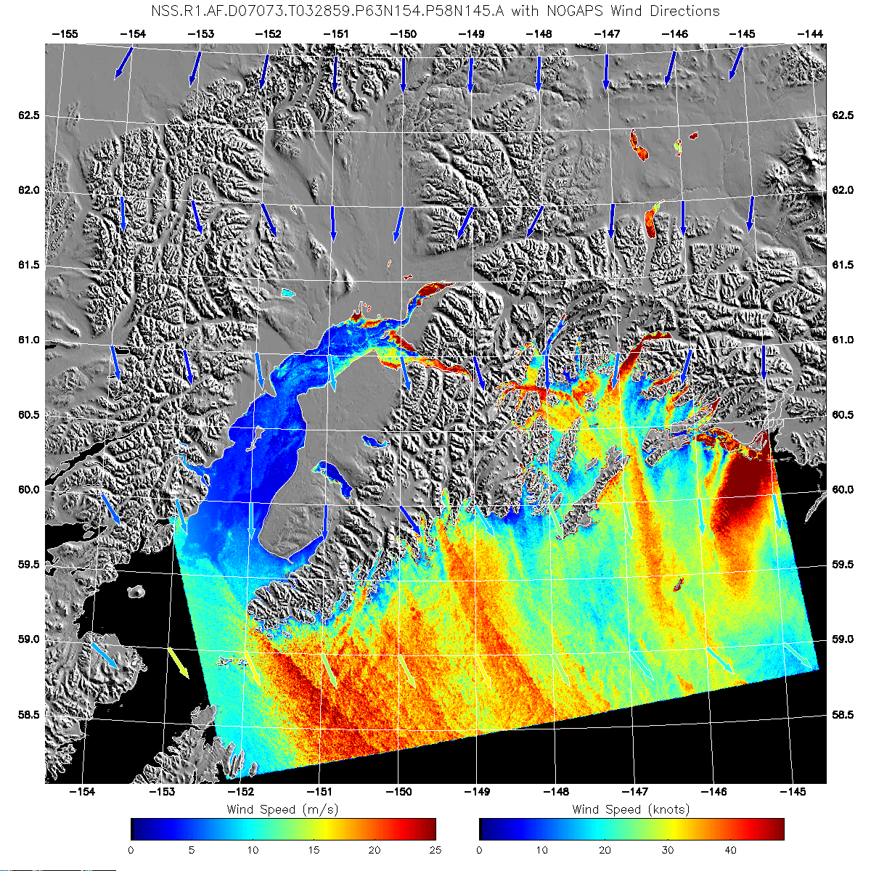
Product Overview
SAR High-Resolution Coastal Wind Product
SAR Wind Product
Derived from the calibrated normalized radar cross section of a SAR image (C-, L-, or X-band) using a priori information on wind directions
Horizontal resolution: 500 meters
Accuracy:
1 m/s (bias) <2.5 m/s (RMS) for wind speeds of 3-15 m/s, less accurate for 16-50 m/s
Timeliness: 1-4 hrs
Coverage Priority
Alaska
Washington State
Gulf of Mexico during
hurricane season
Radarsat-1 ScanSAR Wide 03/14/2007 03:29 UTC
Kenai Peninsula and Prince William Sound, AK

Slide 7
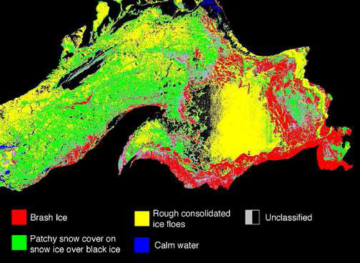
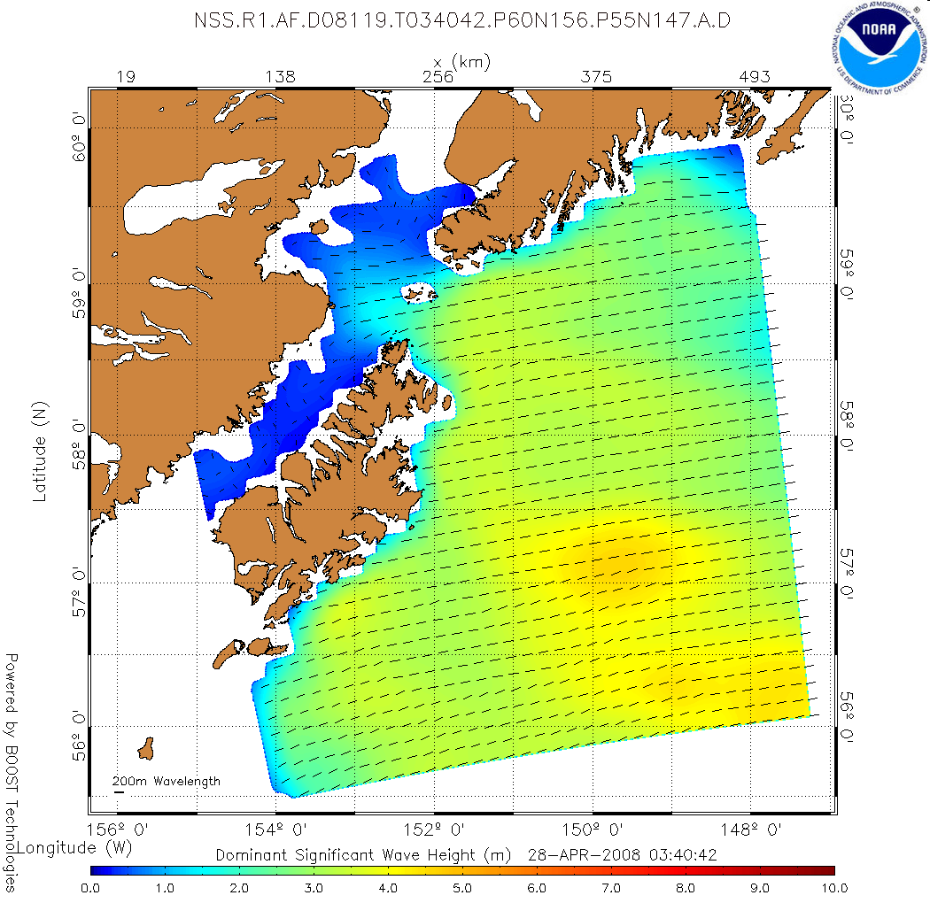
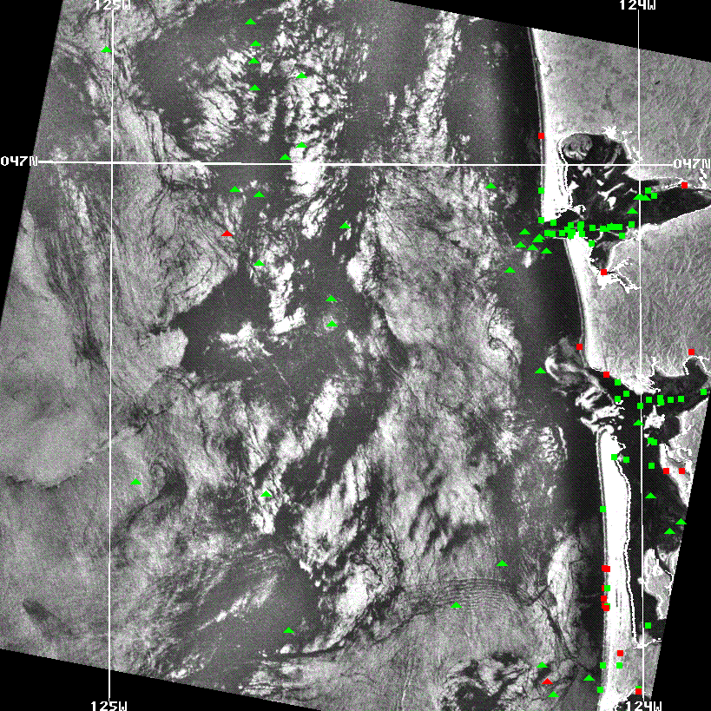
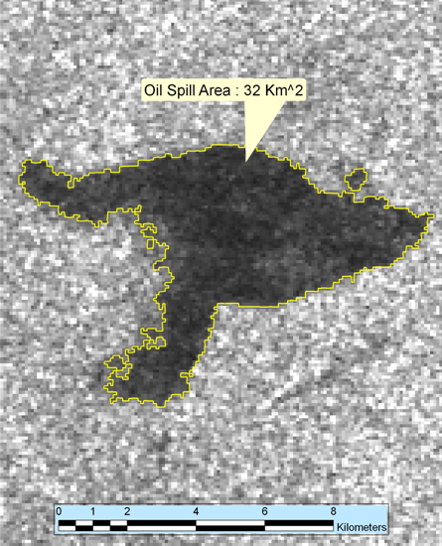
SAR Marine Products System
The SAR winds product is expected to be the first of several SAR-derived products to be transitioned to automated operations
Great Lakes Ice Classification
Vessel Detection
Wave Parameters
Oil Spill Map

Slide 8
SAR Wind Algorithm Details
SAR Data Calibration: Using calibration that comes with SAR data
SAR Data Land Masking: Global Self-consistent Hierarchical High-resolution Shoreline (GSHHS)
SAR Data Averaging:
Average to 0.5 km resolution, regardless of SAR data resolution
Geophysical Model Functions:
C-band: CMOD5
L-band: JAXA Algorithm (Shimada)
X-band: X Mod 0 (APL)
Notes:
8

Slide 9
SAR Wind Algorithm Details (Cont.)
Polarization Ratio:
C-band: Mouche or 0.6 (Thompson)
L-band: Need to develop
X-band: X Mod 0 (APL)
Wind Directions:
GFS model 10-m surface wind directions (default
source)
Wind-aligned wind directions from SAR data
If research is successful, the final algorithm will
combine GFS and SAR wind directions.
Notes:
9

Slide 10
Synthetic Aperture Radar (SAR) Satellite Missions
02
03
04
05
06
07
08
09
10
11
12
13
14
15
ESA: ERS-2
ESA: ENVISAT
Canada: RADARSAT-1
Canada: RADARSAT-2
Japan: ALOS/PALSAR
Germany: TerraSAR-X /Tandem-X (3-Sats)
TerraSAR-X (2 satellites)
Italy: COSMO-SkyMed (4-Sats)
ESA: Sentinel-1 (2 Sats)
On orbit
Approved
Japan: ALOS 2
Planned/Pending
Canada: - RADARSAT
Constellation Mission (3Sats)
Principal
Data Sources
US: DESDynI
Operational Phase Begins
Notes:
10
ALOS failed early in April 2011. ERS-2 is being turned off in July 2011. ENVISAT has replaced ALOS as a Principal Data Source.

Slide 11
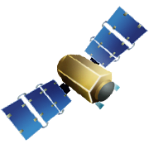
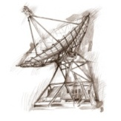
SAR Operational Data Flow (2012)
RADARSAT 1/2
ENVISAT /
Sentinel-1
ESA and CSA Reception
Stations (and perhaps ASF) and
ESA Rolling Archive
Tromso, Norway and
Gatineau, Canada
Internet/FTP
ESPC
Data Distribution
System
Internet/FTP
Internet/FTP
Acronyms:
ASF = Alaska Satellite Facility
CLASS = Comprehensive Large Array-data
Stewardship System
ESPC = Environmental Processing Satellite Center
NAIL = North American Ice Link
NIC = National Ice Center
OSPO SAR
Operational
Product Processors
Internet/FTP
NIC NAIL
STAR SAR Developmental
Product Processors
Notes:
11
Deleted ALOS. ENVISAT upgraded to a primary data source.

Slide 12
Future SAR Product Processing Chain
Level 1 Processed Multilook SAR Imagery
Source A
Level 1 Processed Multilook SAR Imagery
Source A
Level 1 Processed Multilook SAR Imagery
Source A
Level 1 Processed Multilook SAR Imagery
Source B
Standardized SAR Data Ingestor
Processing and Calibration
GFS or Other Wind Directions
Land Mask (Binary)
NRCS (Binary)
Metadata (ASCII)
GeoTiFF, PNG, KMZ, Shapefile, TXT
Wind Speed
NetCDF4 Level 2 &3
Format Product Output
Buoy Winds
ASCAT Winds
Model Winds
Validation
CoastWatch Website

Slide 13
System Upgrades During Transition to Operations
Improved data flow
Data directly from the providers - eliminate CLASS from front end
New front end data ingestor
Read all satellite data formats and create a standard metadata / data file format for use by all product processing
Capability to handle much larger data sets (5k x 20k and larger)
Improved Land Masking
Improved Model Wind Directions
NCEP Global Forecast System replacing NOGAPS
SAR Derived Wind Directions
Automate Validation
Documentation Standards
Product Delivery via CoastWatch
Implement Parallel Processing

Slide 14
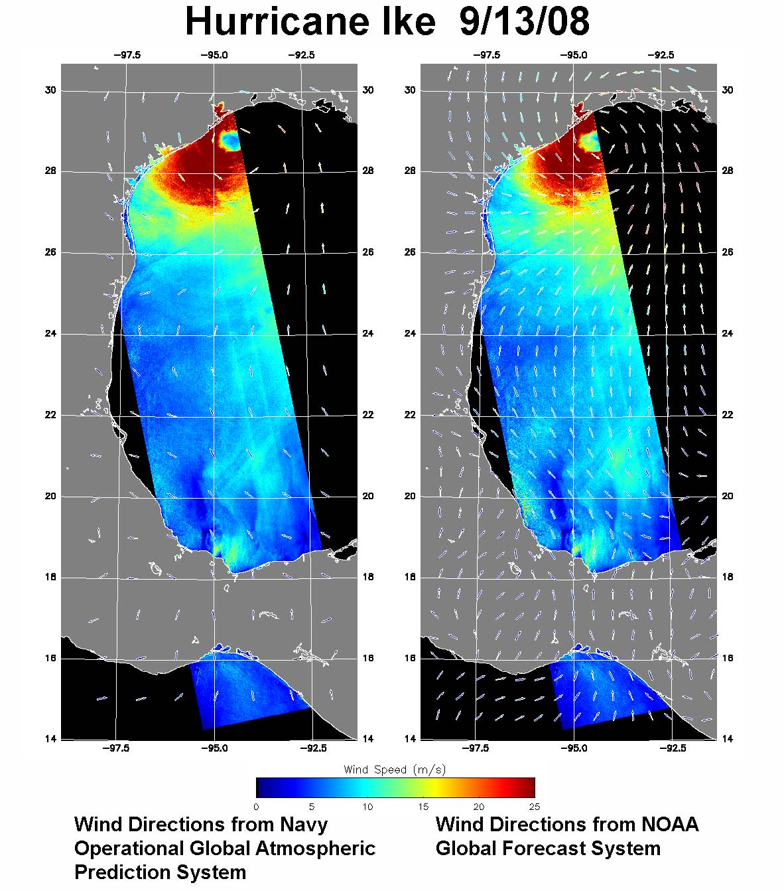
Sources of Wind Direction Information
Synthetic aperture radar (SAR) wind speed measurements require a priori information on SAR wind direction.
Sources:
NOAA Global Forecast System (GFS),
Navy Operational Global Atmospheric Prediction System (NOGAPS),
NOAA Atlantic Oceanographic and Meteorological Laboratory (AOML) Surface Wind Analysis,
National Oceanographic Partnership Program (NOPP) winds, and
Wind-aligned features in the SAR image itself.
NOGAPS GFS

Slide 15


CoastWatch
CoastWatch:
A national program within NOAA to produce and distribute satellite-derived ocean products via regional NOAA laboratories that provide local user support to a diverse marine user community (Atlantic, Pacific, Gulf of Mexico/Caribbean, Great Lakes, Hawaii, and Alaska).
SAR Products will be distributed by CoastWatch along with SST, Ocean Color, scatterometer ocean surface winds and other satellite-derived ocean products.

Slide 16
SAR Winds Output Data Formats
The principal output product of the SAR High-Resolution Coastal Winds will be data files in NetCDF4 format
Level 2 (contains SAR data and other ancillary data necessary for re-processing, distribution restricted)
Level 3 (re-sampled to rectilinear grid with no SAR NRCS data for open distribution)
The Level 3 files will be processed into “standard products” by Coastwatch and delivered to the users via the Coastwatch web site
Wind Image: GeoTIFF
Browse image: PNG
Google Earth: KMZ
AWIPS compatible NetCDF file
Wind Vectors: GIS Shapefile
Near future SAR collection location and time information
Notes:
16
Check with users. Check with NODC. Bill

Slide 17
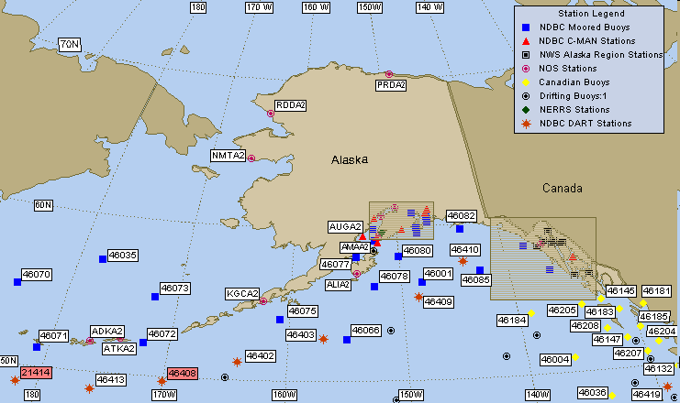
SAR Wind Product Validation
Daily Stability Monitoring : Comparison with model winds
Monthly Validation:
1) Comparison with National Data Buoy Center (NDBC) buoy observations
2) Comparison with ASCAT scatterometer winds
Notes:
17

Slide 18
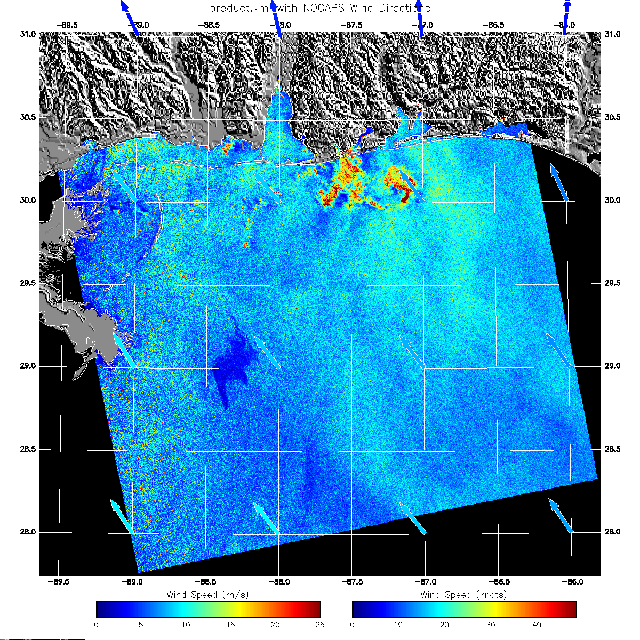
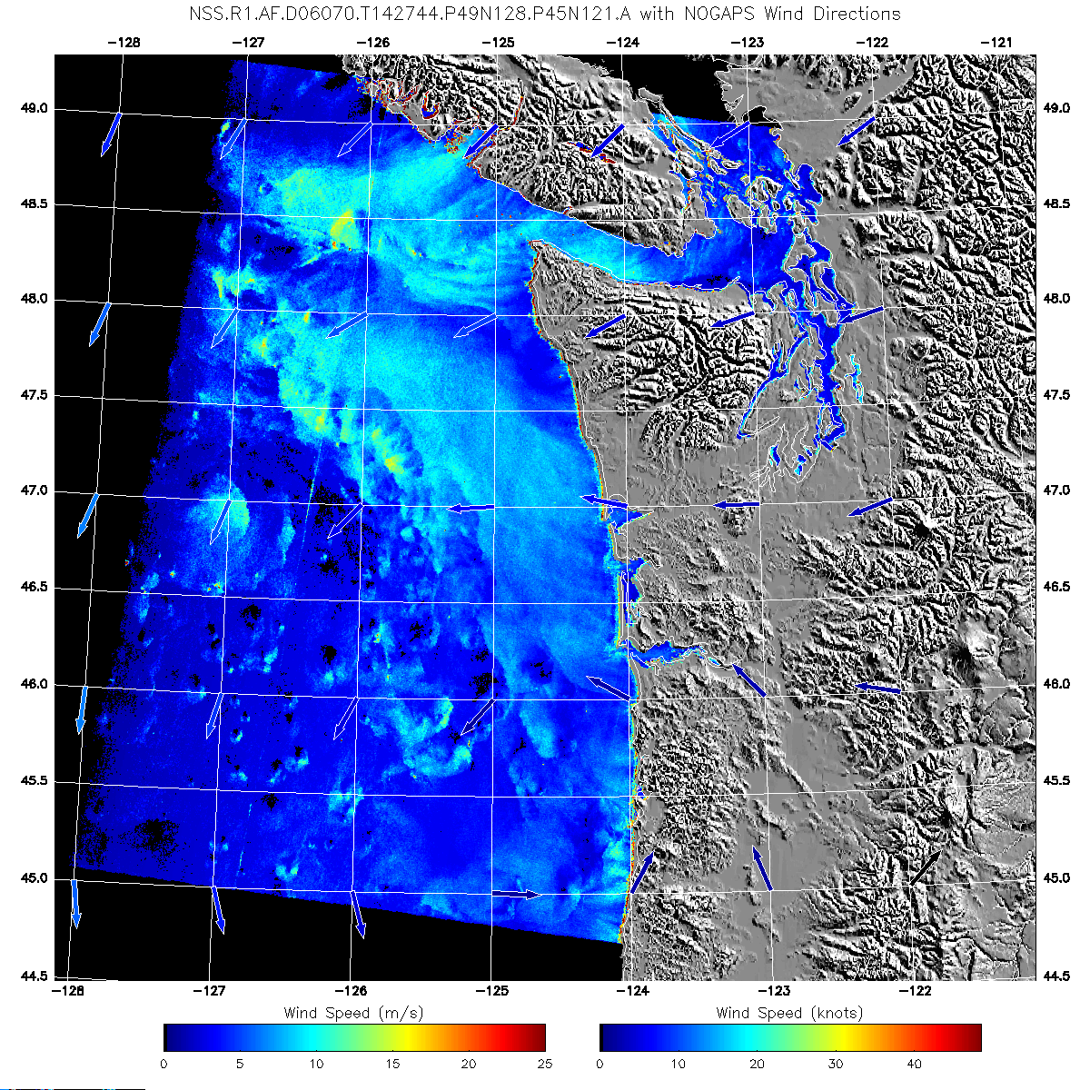
RADARSAT-1/2 SAR Winds
RADARSAT-2 Winds – PNG Wind Image
April 23, 2010 23:49 UT
Dark area center left is the
Deepwater Horizon spill
RADARSAT1 SAR Winds
3/11/2006

Slide 19
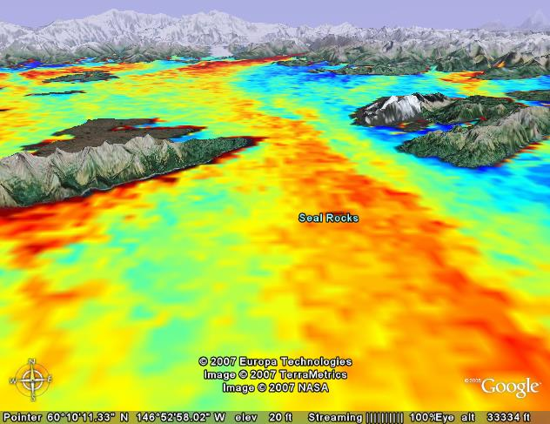
Sample Wind Products
RADARSAT-1 Winds – Google Earth kmz Image
03/14/2007 03:29 UT
Notes:
19

Slide 20
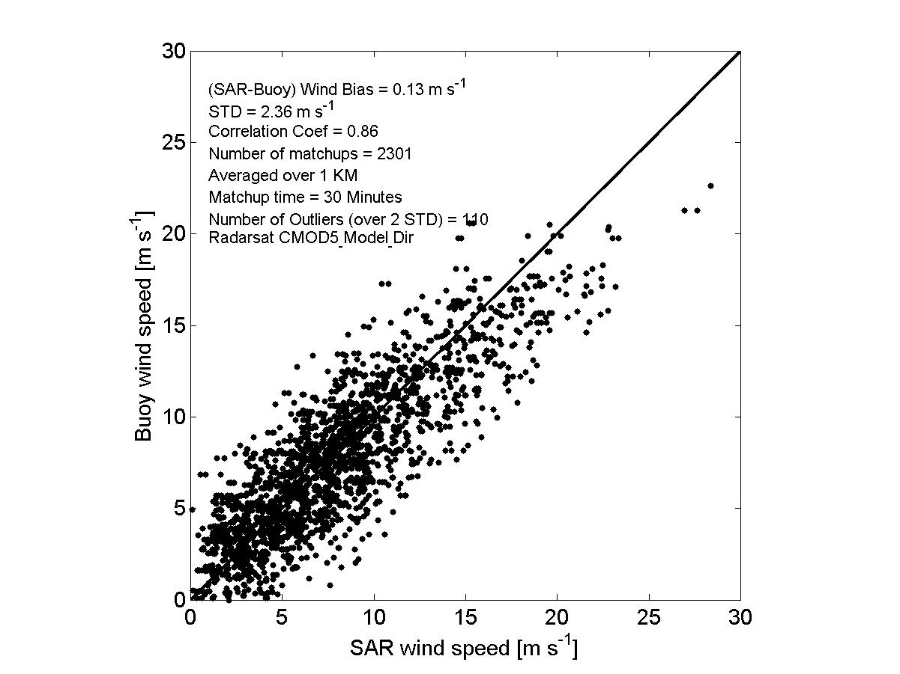
SAR-Buoy Wind Comparison
RADARSAT-1
CMOD5 with Model Directions

Slide 21
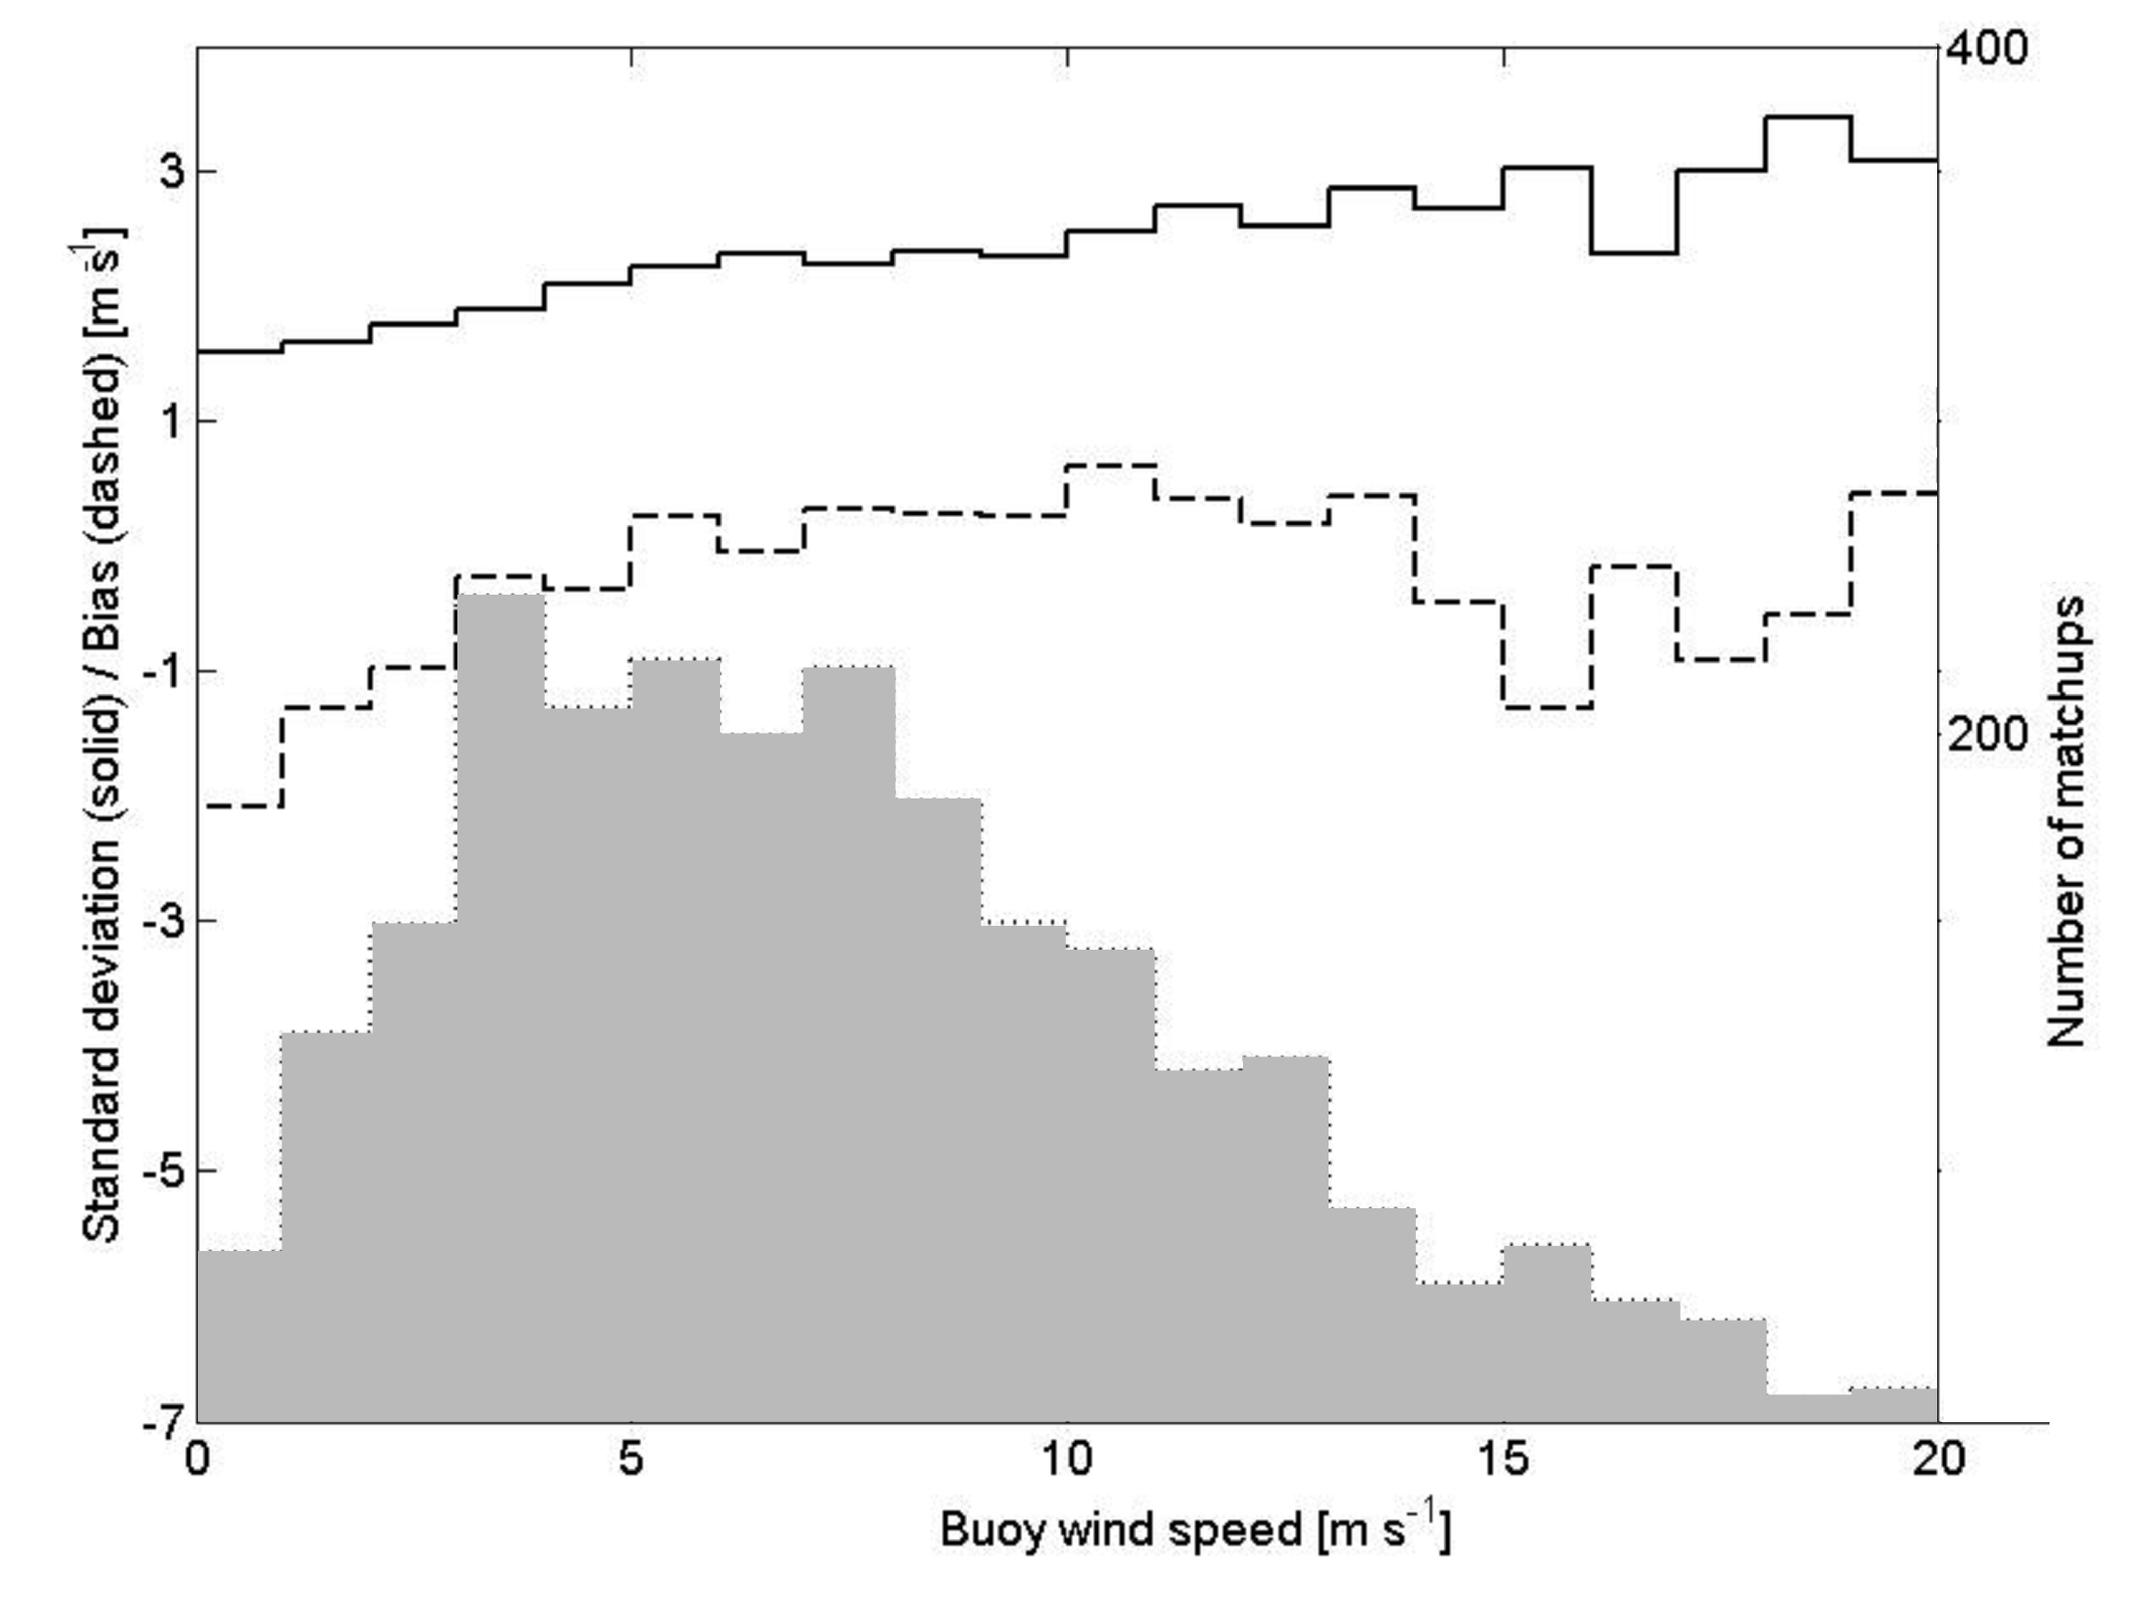
SAR Wind Accuracy as a Function of Wind Speed
STD (left scale)
Accuracy (bias) (left scale)
Number of matches (right scale)
RADARSAT-1 CMOD5 Algorithm with Model Directions
Bias and Standard Deviation (SAR Wind minus Buoy Wind) as a Function of Wind Speed.

Slide 22
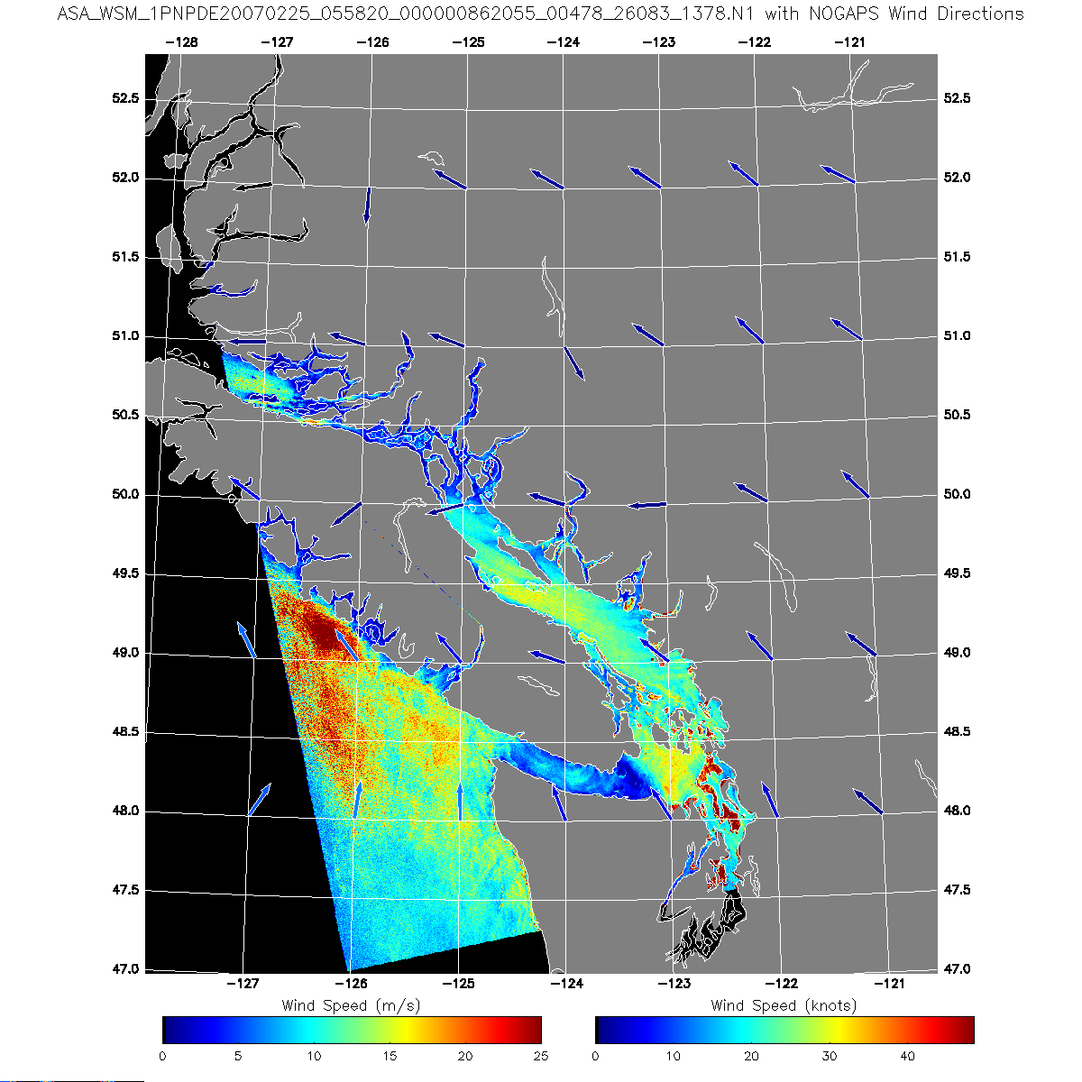
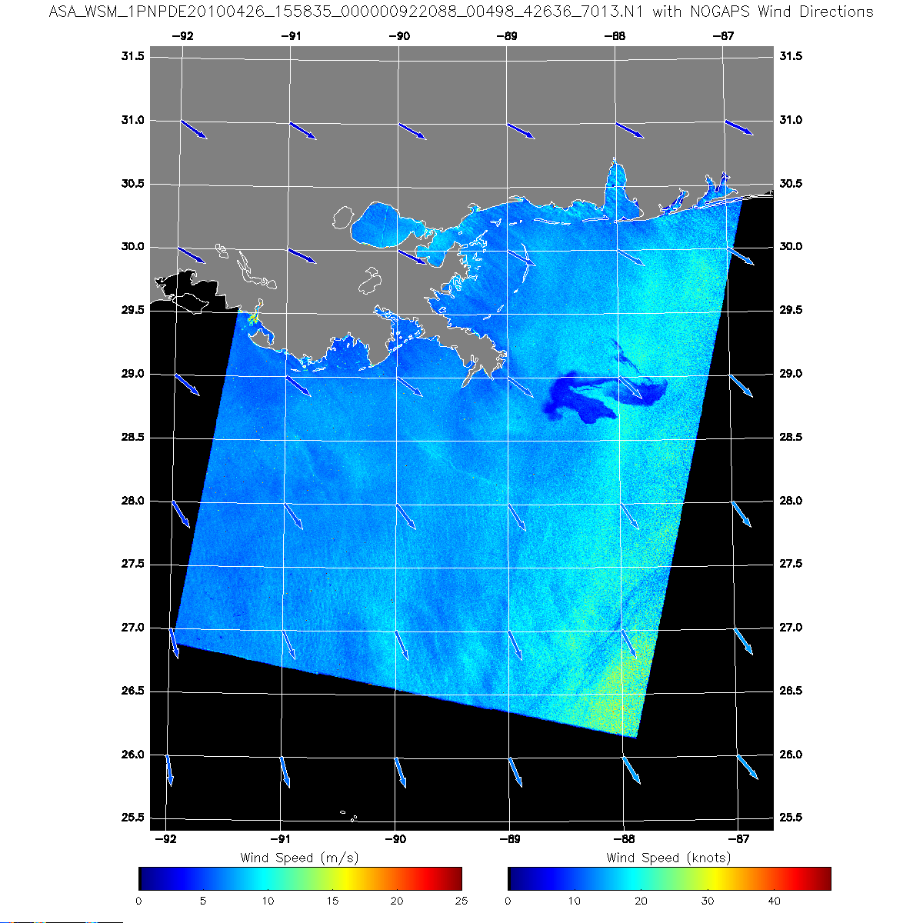
ENVISAT SAR Winds
ENVISAT ASAR Wide Swath Mode Winds
PNG Image 2/25/2007
ENVISAT – PNG Wind Image
April 26, 2010 1558 UT
Dark area center right is the Deepwater Horizon spill

Slide 23
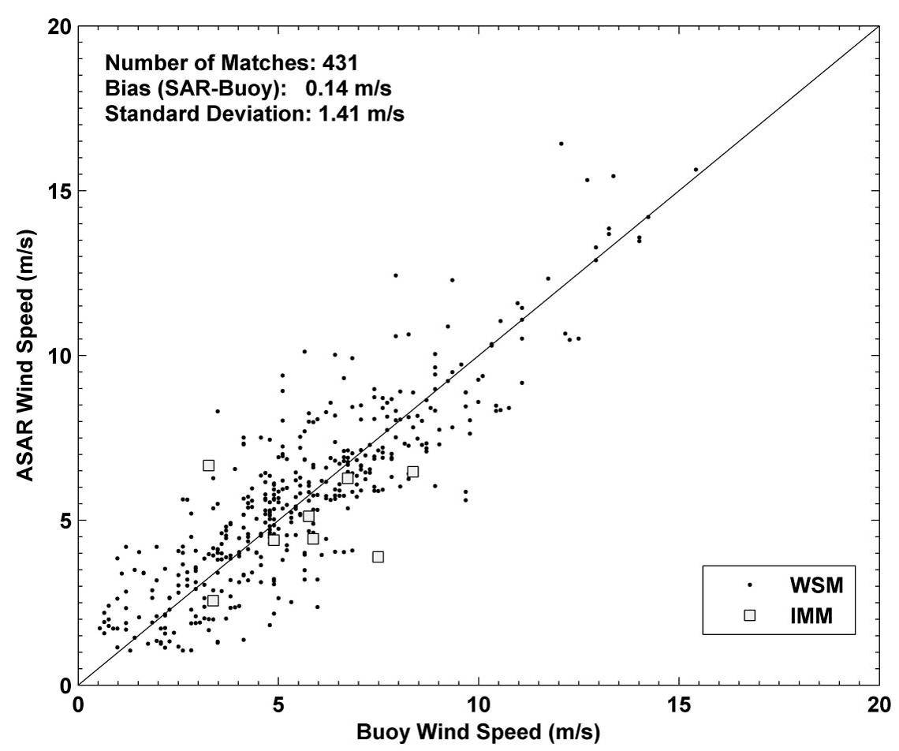
ENVISAT ASAR Validation – Comparison with Buoy Winds

Slide 24
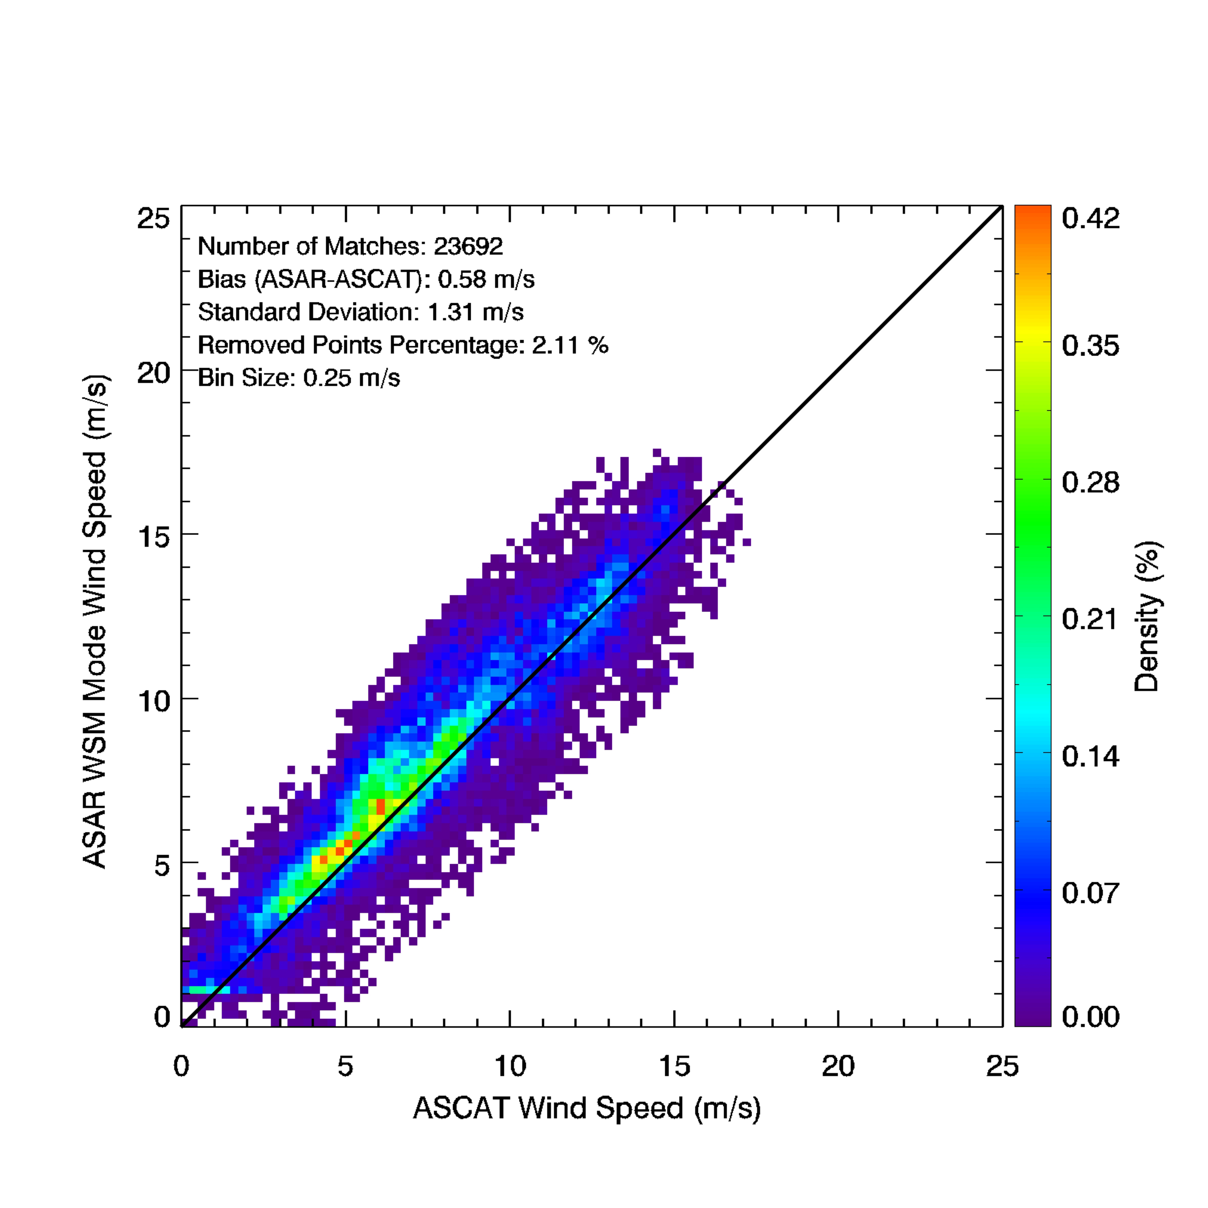
ENVISAT ASAR Validation – Comparison with ASCAT Winds

Slide 25
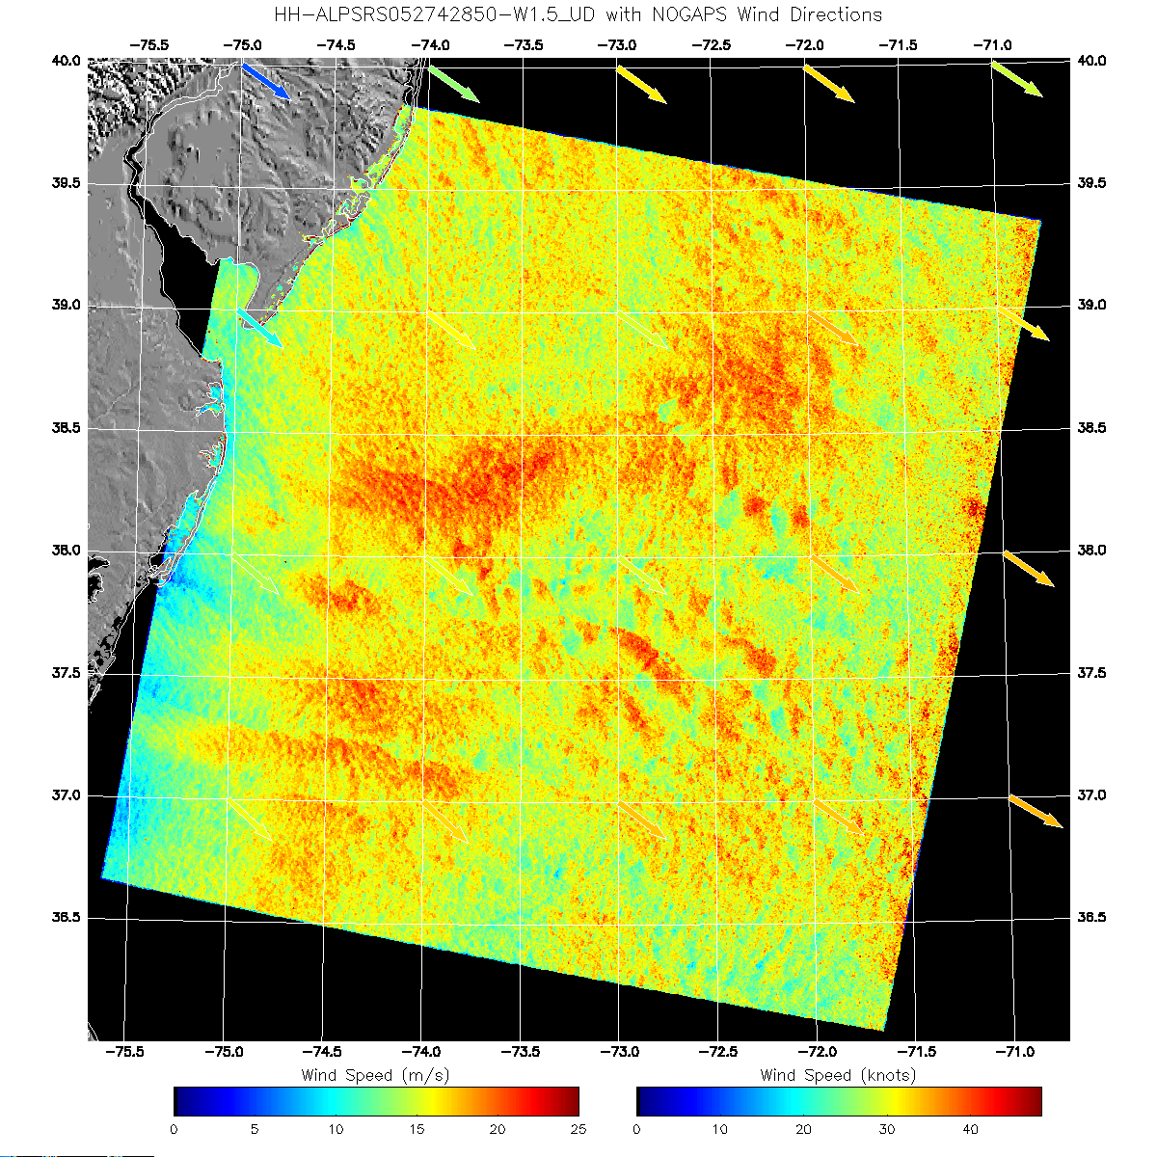
ALOS SAR Wind Image
ALOS Winds
U.S. East Coast

Slide 26
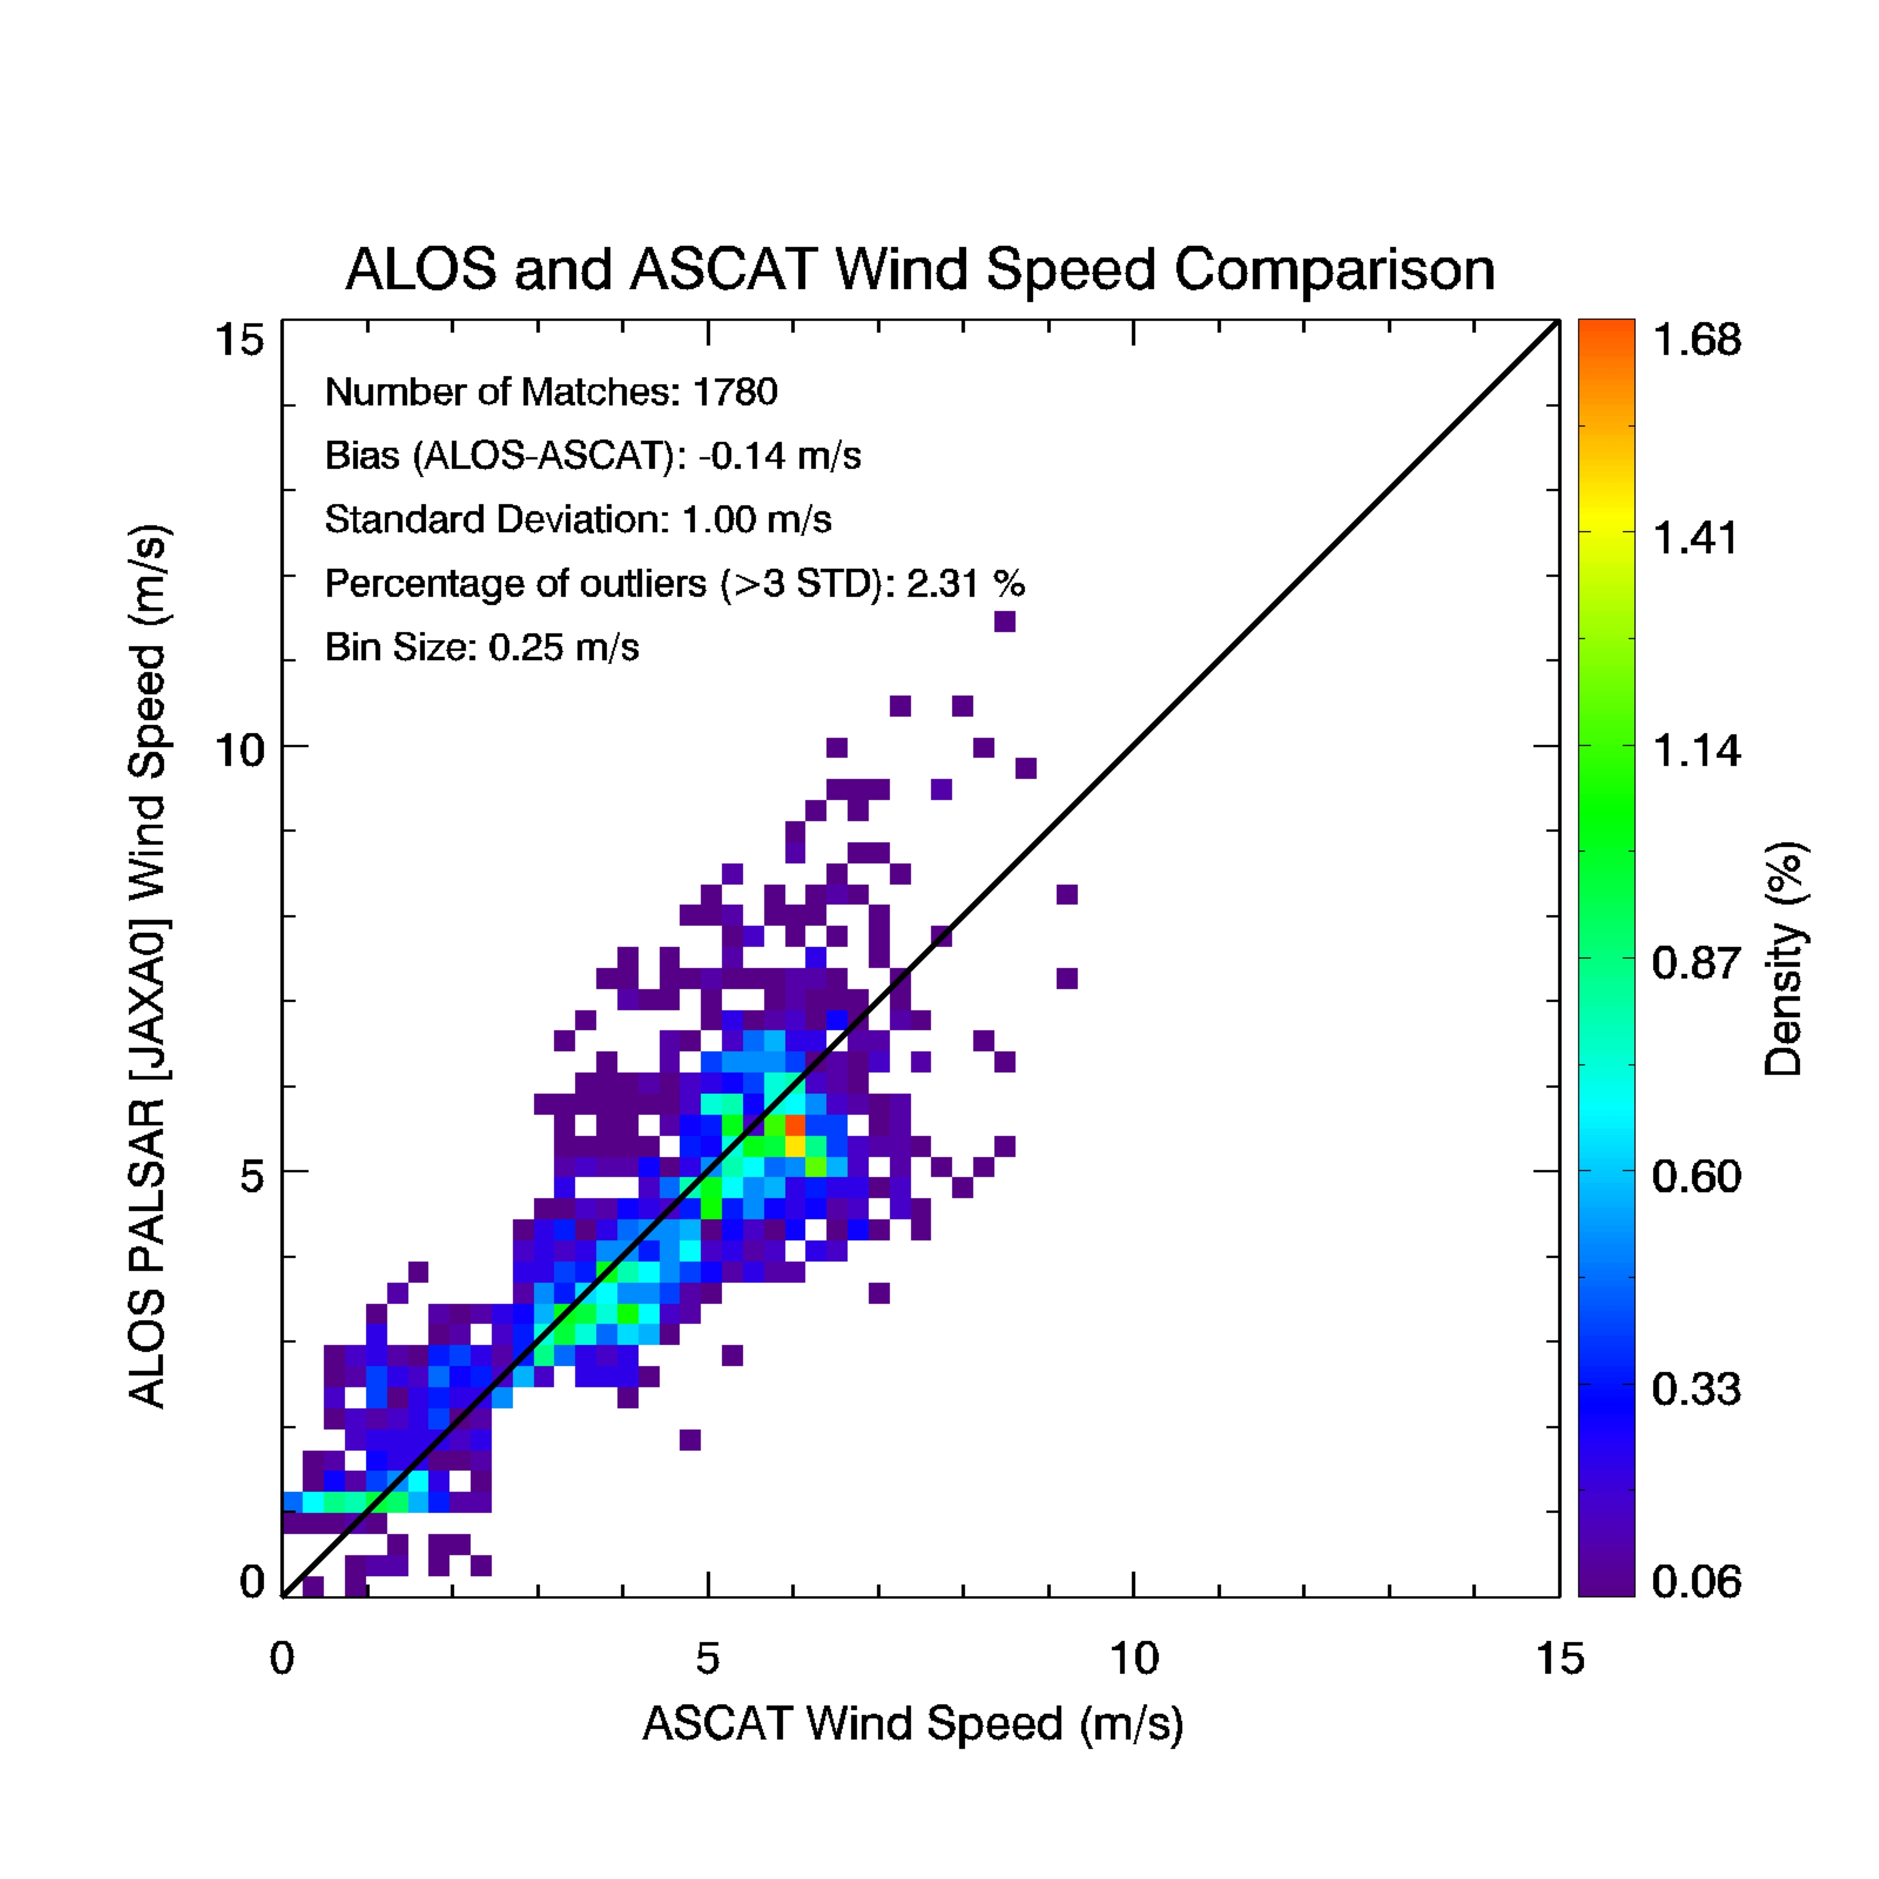

Slide 27
SAR Winds Operational Implementation Schedule
2008 -- Formal User Request to make SAR Winds operational
-- Proposal developed to transition winds from research to
operations
2009 -- Operational implementation approved and funded
-- PDR and CDR
2010 -- Software development – Ingest, Wind, Validation Modules
& 2011 -- Code walkthrough – September 2011
-- Pre-Operational Production – November 2011
2012 – Code and Documentation complete – January 2012
-- Completion of evaluation of pre-operational products – February 2012
-- Begin product archival – May 2011
-- SAR winds operational – May 2011
-- First major operational software update – November 2012

Slide 28
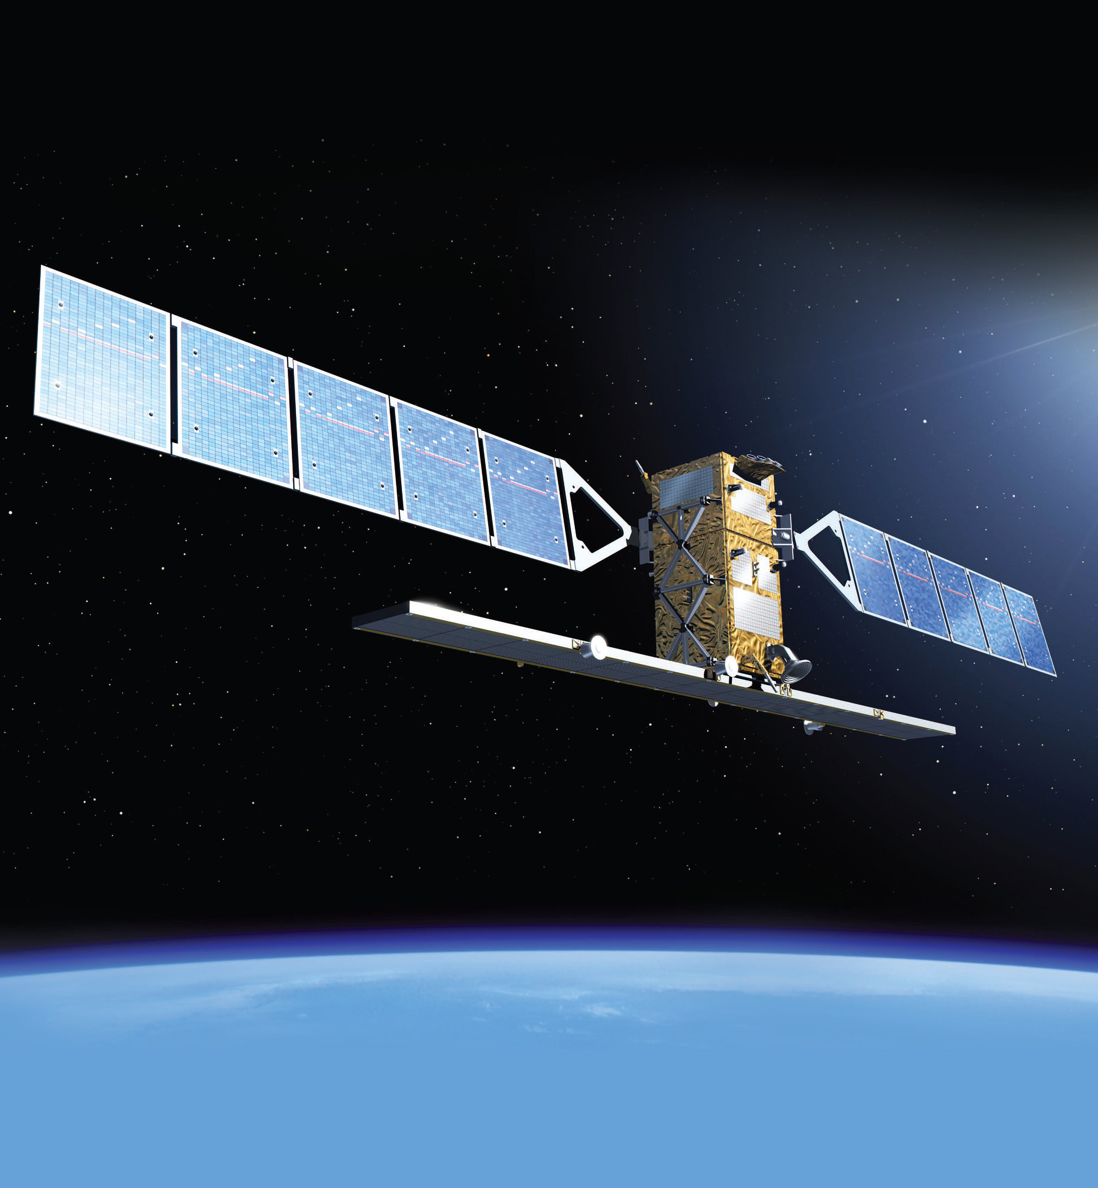
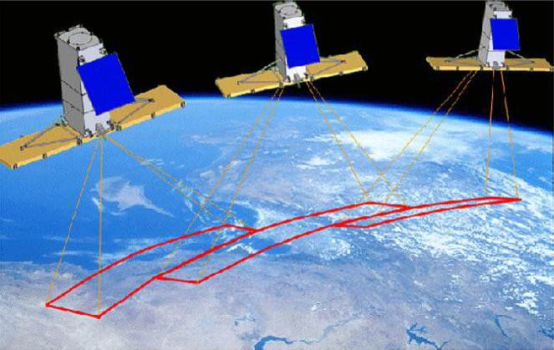
The Future – Operational SAR Constellations
RADARSAT Constellation Mission
3 Satellites
Sentinel-1
2 Satellites

Slide 29
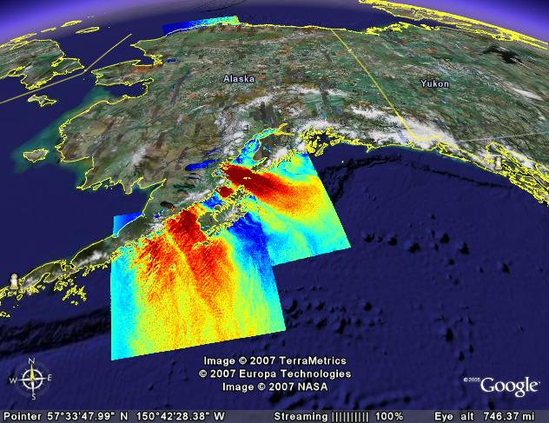
Summary
The SAR Wind product has proven to be of significant utility to government operational offices in Alaska and elsewhere and is mature enough for transition from research to operations. Operational implementation began January 2009 with completion scheduled for May 2012.
Composite RADARSAT-1 (left) and ENVISAT (right) wind images
from March 13, 2007 (4 hours apart) showing gap winds near
Kodiak Island (Google Earth product display).

